Slide 1
NexxusETL 11 STANDARD CONNECTOR
Handbook

Slide 2
Table of Content
INTRODUCTION……………………….………………….……… 02
DATA INTERFACE DOCUMENT……………………..……….… 07
CREATING A DATA LOADING FILE……………………............ 13
MOVEIT………………………………………………....……….... 21
NexxusETL GUI…….…………………………………..…......…. 35
LOADING FASTER WITH DEDICATED JOBS…..…………..... 55
LOADING ONE SINGLE FILE…………………….……………... 62
NexxusETL & ONEKEY DATA LOADING….…………….......... 76
ONEKEY SETTINGS IN NexxusETL….………………….……….. 92
CHANGE REQUESTS MANAGEMENT………………………... 108
DOCUMENT UPDATES .……………………………....……….. 115

Slide 3
Introduction

Slide 4

NexxusETL INTRODUCTION
Key points:
NexxusETL is a standalone dedicated to data Extract Transform & Load (ETL).
It gathers the following characteristics :
Works in 64 bits
Fast loading performance
Front-end user oriented
Prerequisites:
Internet browser plug-in Silverlight must be installed

Slide 5
NexxusETL INTRODUCTION
A Technical User Guide and other documentations regarding NexxusETL are available on Resource center
TCG-NexxusETL_MI11 : Full NexxusETL manual
TCG-Dataload_MI11_QR : NexxusETL Quick Reference guide
DID-MI11 : Data Interface Document
DID-DataTemplate_MI11 : To build easily idl files
TCG-OneKeyViaNexxusETL_MI11
OTH-DropDownListValues-MI11 : to find easily fields used in the data model as well as knowing which values are expected
Notes:
http://crm.cegedim-portal.com/resource/Product/FuncDocs/Mobile%20Intelligence%20Suite/Forms/MI%2011.aspx

Slide 6








NexxusMI MULTI-TENANT ARCHITECTURE
The Master Tenant of the environment contains the baseline configuration of Nexxus MI. It cannot be directly configured
P
Database
Master Tenant
Application
Client 1
Tenant 1
Tenant 2
Tenant 3
Client 2
Tenant 4
Each client has access to their own tenant, where specific configuration can be applied without affecting the other tenants
Client 3
Tenant N
Client 4

Slide 7

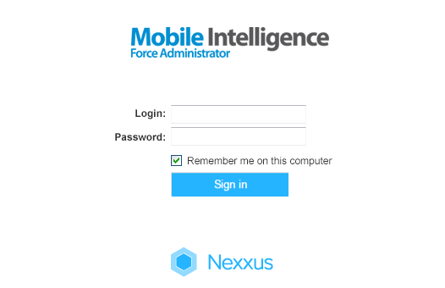
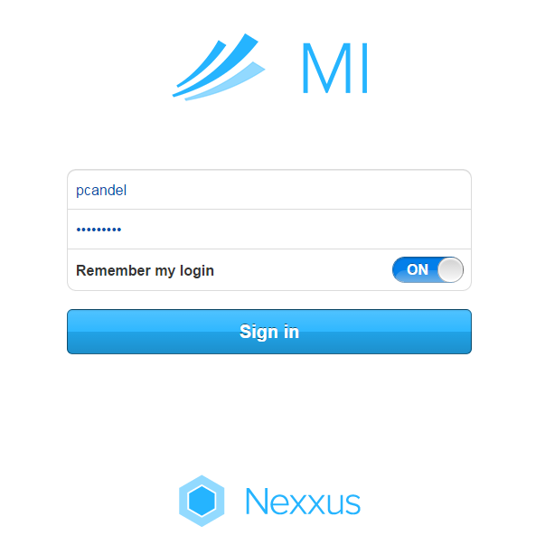



NexxusETL WORKFLOW
MOVE IT
DLS
(Non-OneKey)
Data
1- NexxusETL obtains MoveIt credentials, location of folders in MoveIt, location of concerned folders from the tenant set-up done using Force Administrator
2- NexxusETL then uses this information to access MoveIt and works with the Nexxus MI database
3- NexxusETL services are installed on the Master Application Server
Nexxus MI
Environment

Slide 8
Data Interface Document

Slide 9

Data Interface Document

Slide 10
Data Interface Document
The DID provides the list of data loading interfaces and details the standard format used for historic data load and ongoing data loading
The DID is a worldwide document
The DID evolves with the Nexxus MI versions and modules
The DID is maintained by Application Engineering Team
The loading is managed by the Corporate Technical Implementation or by local teams according to their skills & experience
You can access the DID from here
Notes:
http://crm.cegedim-portal.com/resource/Product/FuncDocs/Mobile%20Intelligence%20Suite/DID-MI11.pdf

Slide 11
Data Interface Document
Structure
1.IDENTIFICATION
File types and field specifications of the data
Flat files (Record Format) /Zip files
2.CONFIGURATION
Loading via NexxusETL
3.INTERFACES
List
Hierarchy
Field dependency
Columns
4.INTERFACES SPECIFICATION DETAILS - IMPORTS
Detail of the fields
Example
Rules
5.INTERFACES SPECIFICATION DETAILS - SALES
6.INTERFACES SPECIFICATION DETAILS - EXTRACTS

Slide 12
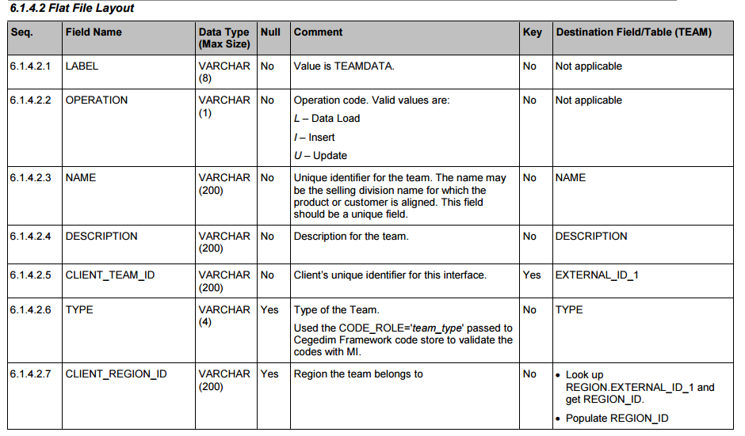
Data Interface Document
If the Null value is no, the field is mandatory

Slide 13

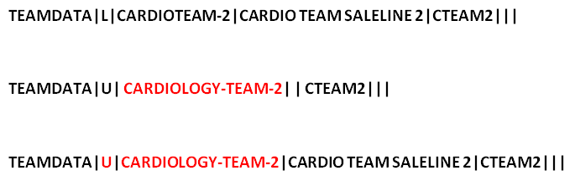
Data Interface Document
Warning: when updating data, all the fields of the original row needs to be filled-in again. If not, they will be deleted.
To update this row:
Incorrect:
Correct:

Slide 14
Create a data loading file

Slide 15
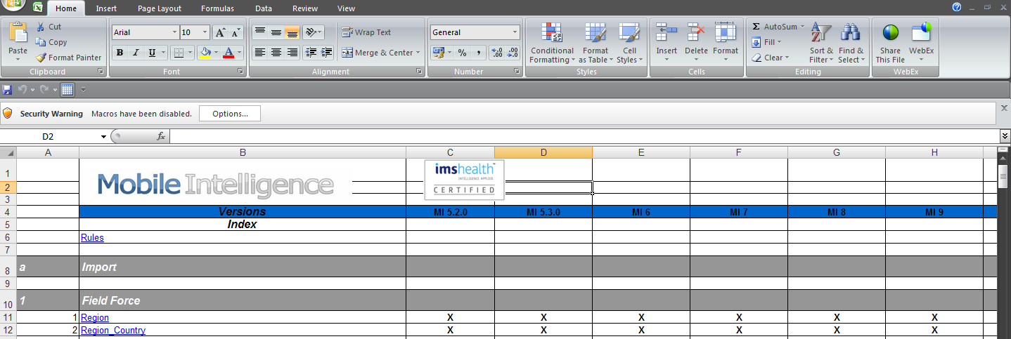
Create a data loading file
It is create IDL files following two methodologies :
Using a text editor and following manually the Data Interface Document
Using the DID-DataTemplate provided by AE at this location.
The document must be saved locally prior being used and macros must be enabled
Notes:
http://crm.cegedim-portal.com/resource/Product/FuncDocs/Mobile%20Intelligence%20Suite/DID-DataTemplate_MI11.xls

Slide 16
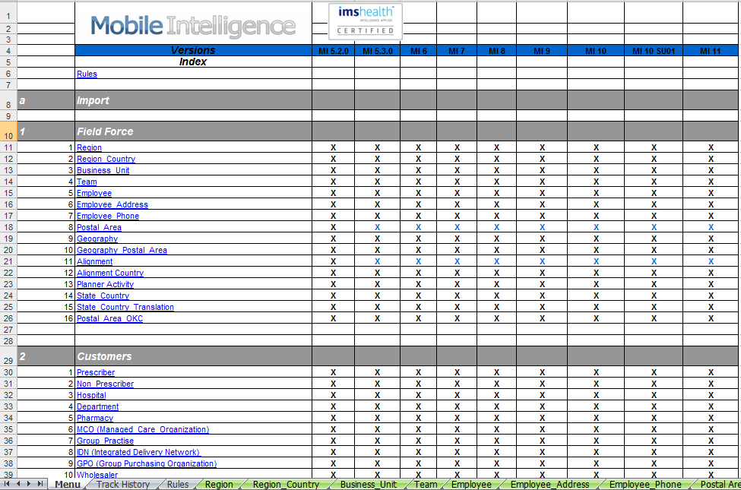
Create a data loading file
On the first tab of the document, the list of interfaces is available.
To start the flat file creation, click on the name of the interface.

Slide 17
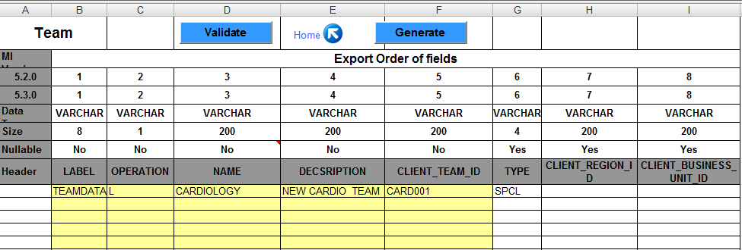
Create a data loading file
Then, the form has to be filled. Some of the fields are drop downs, others are free text…The information must match with the format defined in the DID.
Note that the yellow fields are the mandatory fields.

Slide 18
Create a data loading file
Click on ‘Validate’ to check that the format matches with the DID.
Once done, click on ‘Generate’ to generate the flat file.
The idl file will be created in the same folder as the XLS template. This is why it is important to save the XLS file locally.

Slide 19
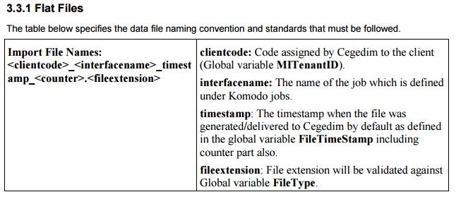
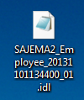

Create a data loading file
Counter is the version number of the idl file
Time stamp format can be retrieved in the DID

Slide 20
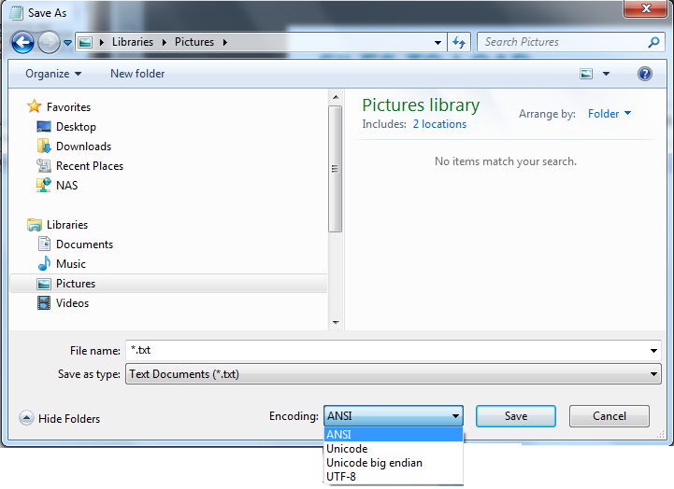

Create a data loading file
All loading files should be in UTF-8 Format.
ANSI formatted files will be processed but special and accentuated characters will be incorrectly interpreted and will be displayed in the Front-end as “?”. Be careful if using Windows Notepad, since, by default, files will be saved in ANSI.
Also, configure your Operating System to show file extensions in order to prevent errors in file naming.

Slide 21

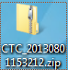
Create a data loading file
Idl file must be in contained in a zip archive before being uploaded on MoveIt. Not archived idl files will be ignored.
The name format must be:
<clientcode>_timestamp.zip
e.g.: CTC_20150801153212.zip

Slide 22
MoveIt

Slide 23
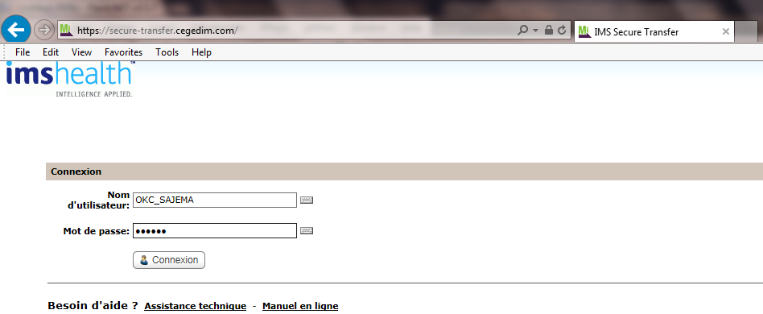
Data loading
MoveIT is a File Transfer Protocol (FTP) used to deposit and retrieve zip archives on and from the Nexxus MI application server.
Login Page

Slide 24
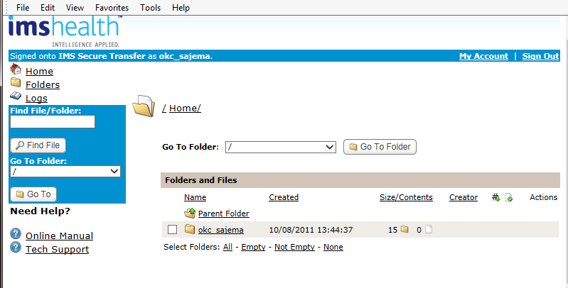
Data loading
Once logged in, select the company folder

Slide 25
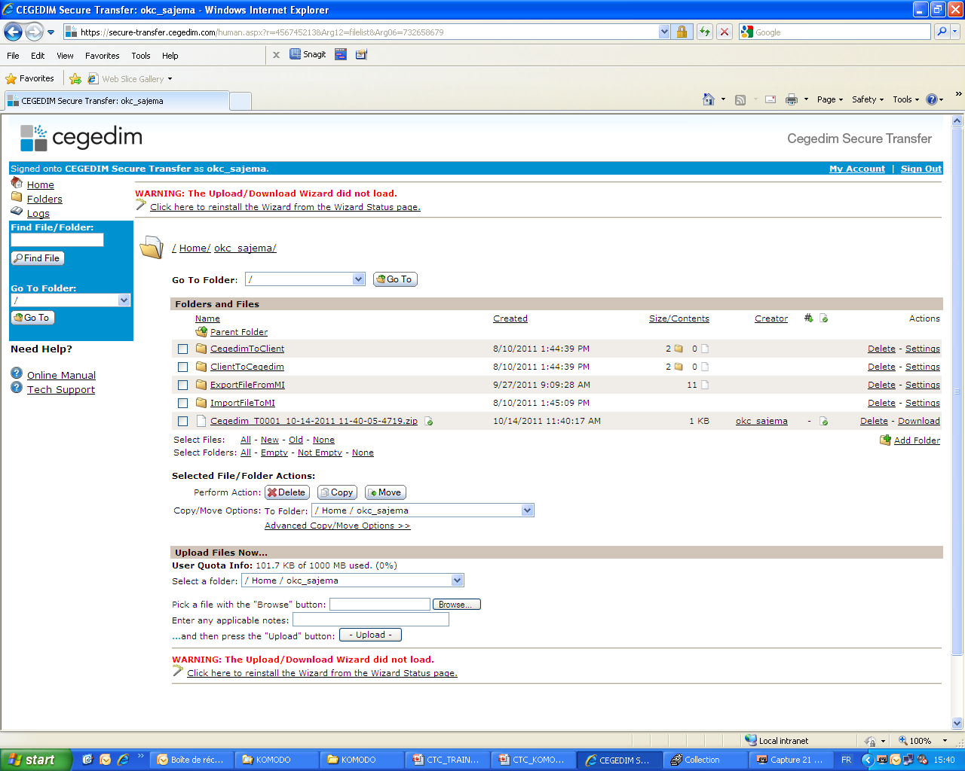
Data loading
And select the ‘ImportFileToMI’ directory
OneKey archives directories (here, “Client” stands for Pharmaceutical client
Non-OneKey archives directories

Slide 26
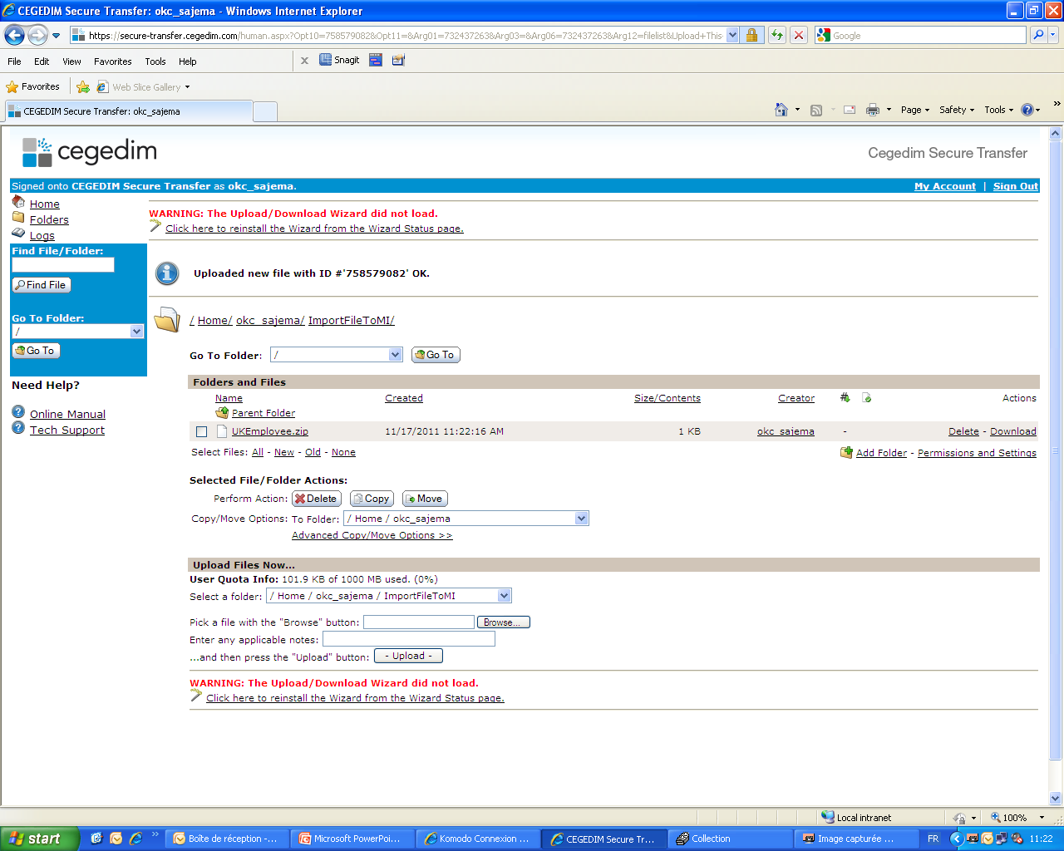
Data loading
2 – Archives for loading appear here
1 - Browse for file

Slide 27
Data loading
In order to receive the files for loading, the Tenant requires some specific set-up
This is carried out in Force Administrator

Slide 28
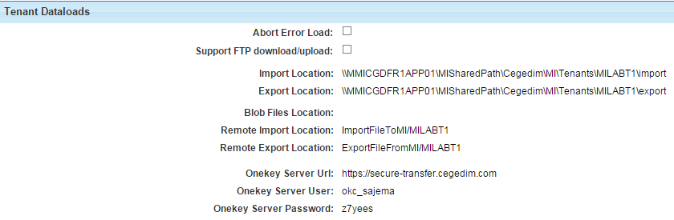
Data loading
In the Tenant, a link with the MoveIt account must be set up
Tenant
Instead of MoveIt, it is possible to use a third party Client FTP
MI server folders
MoveIt folders
MoveIt Address and credentials

Slide 29
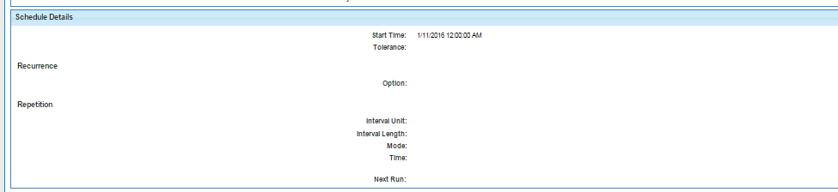
Data loading
In the Tenant, a link with the MoveIt account must be set up
The Schedule Details section of the Tenant Personalization tab is not related to NexxusETL

Slide 30
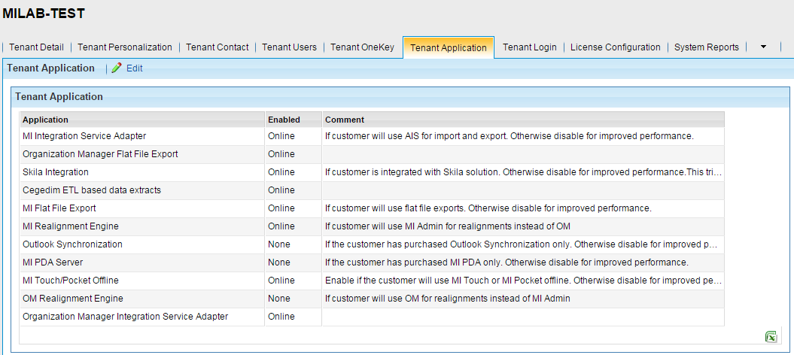
Data loading
If the client requests for incremental data extraction through NexxusETL, this option needs to be enabled.
Enabling this feature is very resource consuming. Do not enable it if it is not used.

Slide 31
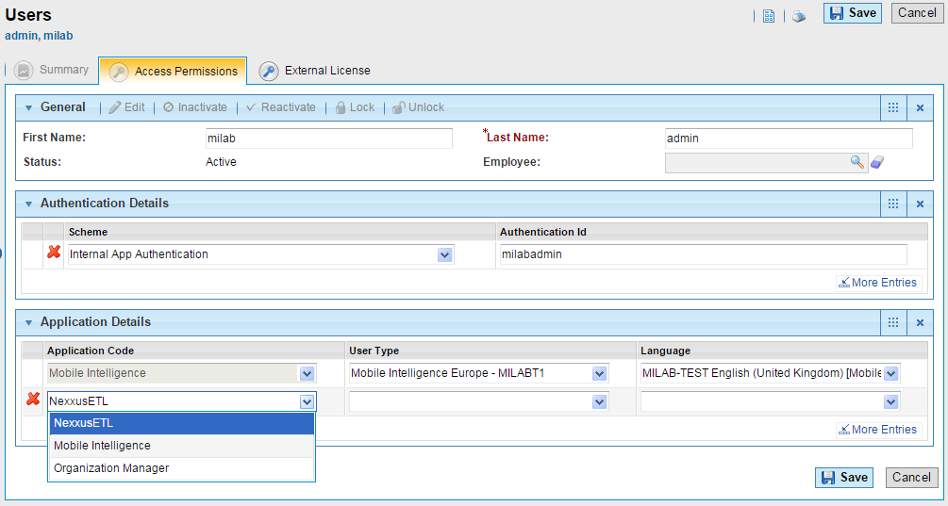
Data loading
Then, additional actions need to be performed in Nexxus MI in order a MI user can access NexxusETL
Add NexxusETL in Application Details section of the user profile.

Slide 32
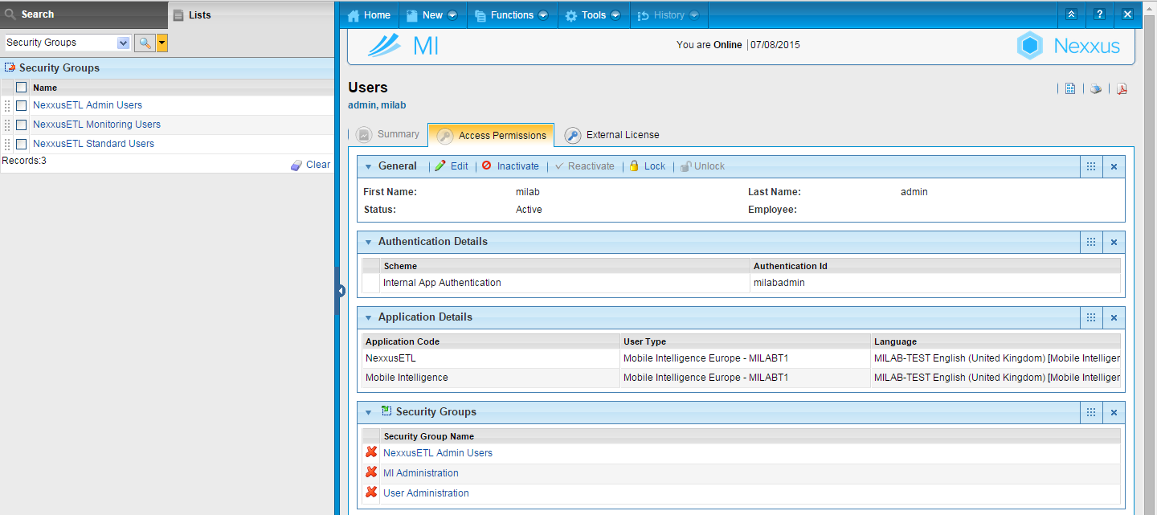
Data loading
2- Add needed security group to the user profile.
If all three security groups are assigned, the highest effective permission and role will be that of Tenant Administrator

Slide 33
Data loading
To register the user in NexxusETL the user will Login to NexxusETL with their MI user ID and password
This will add the user to the NexxusETL Tenant User list and the dlt_user table
A Super User or a Tenant Administrator can modify in NexxusETL the permissions associated with a new NexxusETL user following the rules established for the role
Neither can permanently change the Role assigned to the new user in the NexxusETL tool, this must be done in MI by adding or removing the appropriate security group to the user
NexxusETL users that were created in the former CegedimETL or Komodo tool, not in MI, can still have their Role modified in the NexxusETL tool
Notes:
A Super User or Tenant Admin should login to NexxusETL as the new user ( which registers the user) and then logout / login as Admin and change the permissions to reflect any modifications to the default permissions

Slide 34
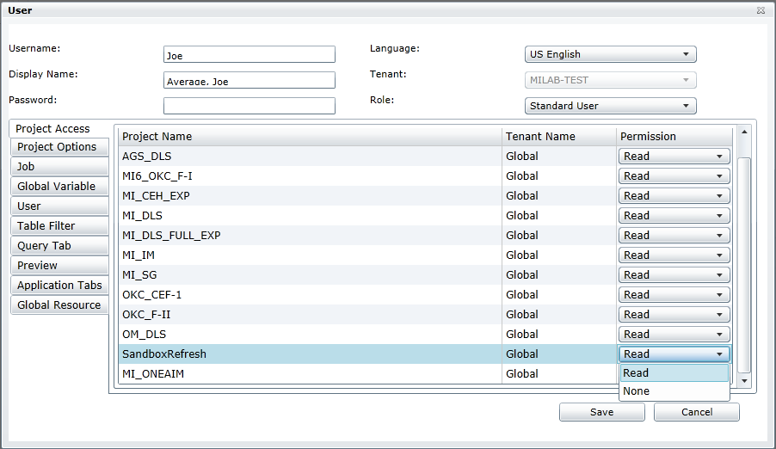
Data loading
A Super User or a Tenant Administrator can modify the permissions associated with a new NexxusETL user following the rules established for the role

Slide 35
Delete a User
Two step process:
1. In MI remove the Security Group from the User – the user will still be listed in the NexxusETL User list but cannot Login to NexxusETL
They receive the “User does not have permission to access the application” message
Note: In MI if the NexxusETL Application Code is removed the User will receive the “Invalid Password or Login” message
2. As a Tenant Administrator or Super User login to NexxusETL
Expand the Tenant User list, right click on the NexxusETL user to be delete and select Delete

Slide 36
NexxusETL GUI

Slide 37
NexxusETL
NexxusETL requires one Super User account which is created during installation.
Super User credentials are used to create tenant Standard Users and Tenant Administrators.
They can run and modify jobs
They have a read and write access on components and corresponding projects for all tenants in the Project Explorer.

Slide 38

NexxusETL
MOVE IT
DLS
(Non-OneKey)
Data
1- The File is ready for loading (correct format and location on the MoveIt account)
The Tenant is set up for data loading
The user has all needed accesses
The job must now be scheduled from NexxusETL
Nexxus MI
Environment

Slide 39
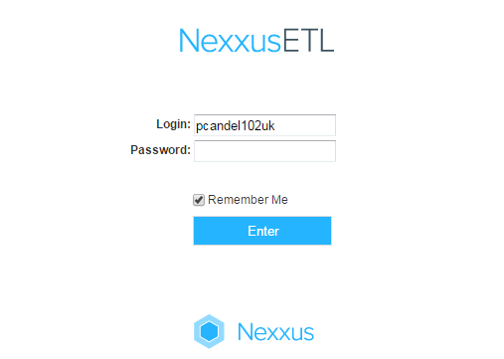
NexxusETL
If a new NexxusETL user is created, the password is the same as the login on first connection.
For an existing MI user, the login remains as is for Nexxus MI

Slide 40
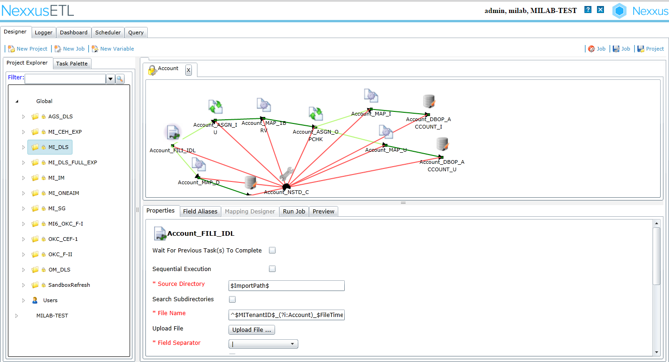
NexxusETL
The Home Page gives access to central Information
Error messages
The Designer view
Standard interfaces (DID)
NexxusETL access is Tenant limited
Tenant specific interfaces can be created here
(NexxusETL Advanced Connector Training)

Slide 41
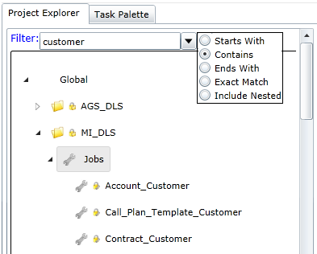

NexxusETL
Expand the Jobs node of the project to see the results or click
The search is not case sensitive
The search criteria choice by default will be the previous selection
Subsequent searches will be invoked as a new search, not a filtering of the previous result set
The locker icon warns that the regular user cannot modify and save baseline jobs and projects.
Only the standard interfaces for loading (included in the DID) appear here in the Global section

Slide 42
NexxusETL – Enhanced Session handling
If the application has been closed because of a session timeout, NexxusETL will re-open in the last state after a re-login.
Services and server directory structure names have not been changed to NexxusETL, they remain with the previous name Komodo…

Slide 43
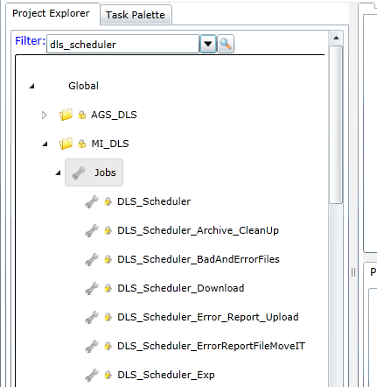
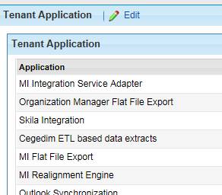
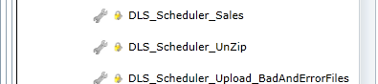
NexxusETL – Enhanced Session handling
Select one of the following to schedule your job:
DLS_Scheduler: To load files in Nexxus MI
DLS_Scheduler_Exp: To extract files from Nexxus MI
DLS_Scheduler_Sales: To load sales data in Nexxus MI

Slide 44
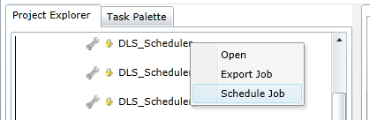
NexxusETL
Right click on the one you need to perform then click on ‘Schedule Job’ (here ‘DLS_Scheduler’)

Slide 45
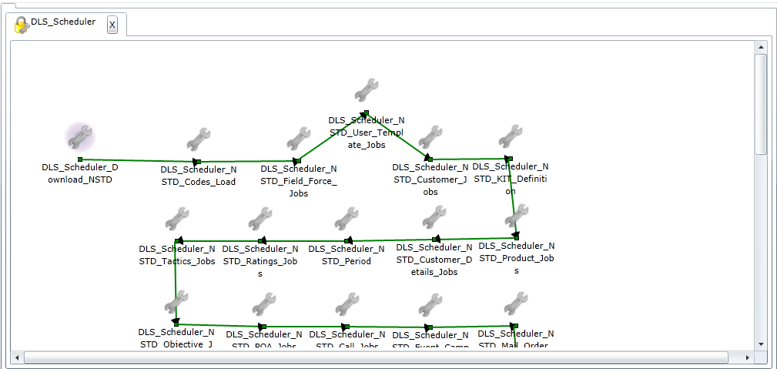
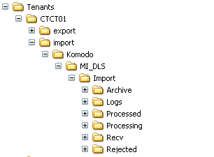
NexxusETL
When DLS_Scheduler is running for the first time, it creates on the MI server a tree structure of folders at the tenant level thanks to a nested job called DLS_Scheduler_Download

Slide 46
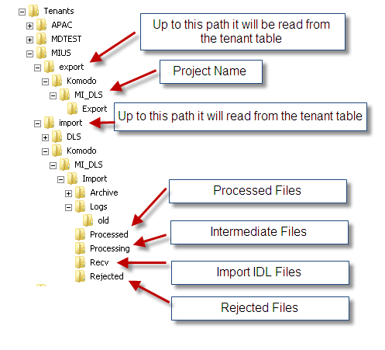
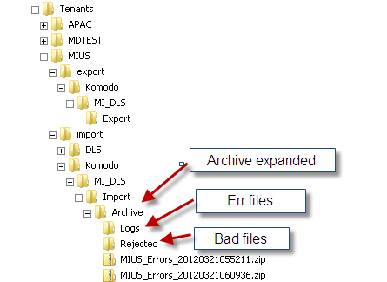
NexxusETL
Server directory structure for NexxusETL MI_DLS project

Slide 47
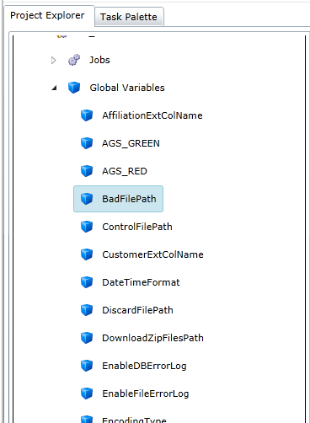
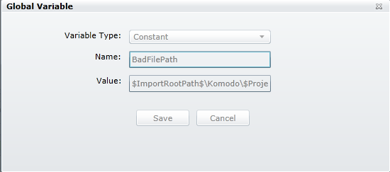
NexxusETL
DLS_Scheduler also applies all global variables to the interfaces (still at the current tenant level)

Slide 48
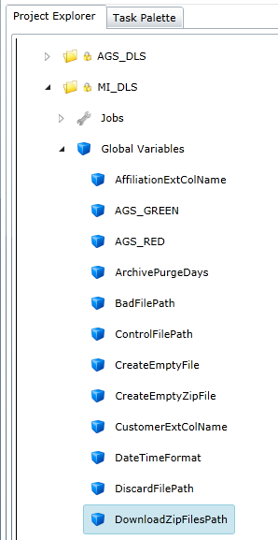
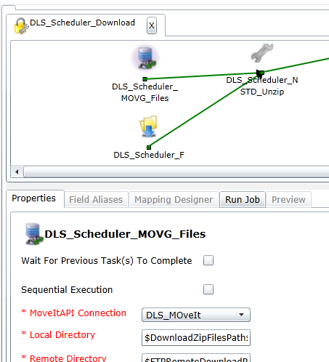
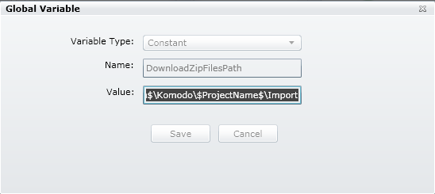
NexxusETL
DLS_Scheduler also applies all global variables to the interfaces (still at the current tenant level)

Slide 49
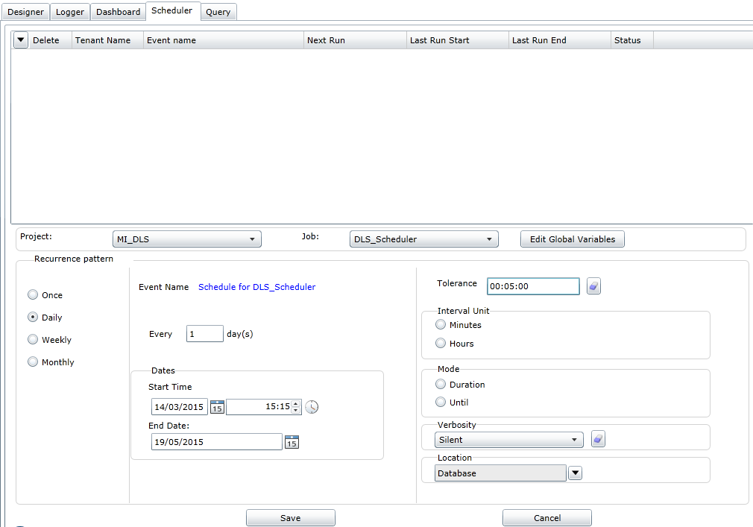
NexxusETL
Additional time to start the job. Here the job can only start between 14:18 and 14:28
No change should be done here
Here, the data load is scheduled every day
Select ‘Silent’ to receive error title only
Beginning of the loading
Select database to receive all the error logs

Slide 50
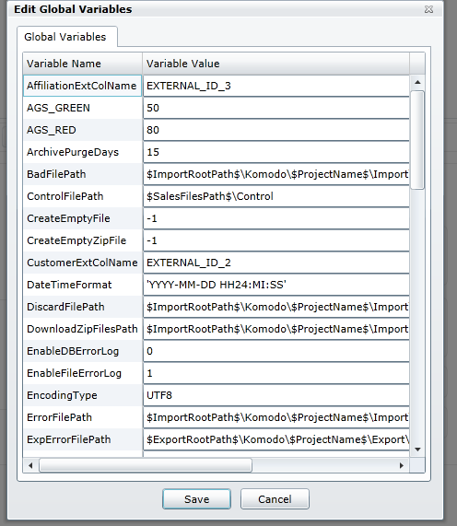
NexxusETL
No change to task flow or global variables should be done here!

Slide 51
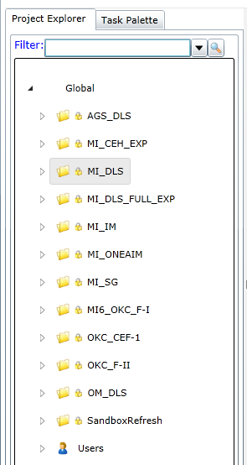
NexxusETL
Global Baseline projects available in NexxusETL 11
Export to Aggregate Spend
Export to Customer Engagement Hub
DLS data loading to MI database
Export full MI database tables to .idl files
Export to Incentive Compensation Management
One AIM solution project
Export to Sample Guardian
OneKey data loading in F-I format
OneKey data loading in CEF-1 format (since MI11)
OneKey data loading in F-II format
Organization Management dedicated project
Used by the sandbox refresh process

Slide 52
NexxusETL
Global Baseline projects available in NexxusETL 11
AGS_DLS
This project consists of export jobs that will export Aggregate Spend data from the MI database to new corresponding .idl files in the form of the new Aggregate Spend 7.0 interface layout format.
The main job is the DLS_Scheduler_Exp job that will execute all the AGS jobs and generate job logs and failed records files.
MI_IM
This project exports MI data to output files that will be used by Incentive Compensation Management. There are two variations of the main job that can be run or scheduled, DLS_Scheduler_With_Email_Exp or DLS_Scheduler_Without_Email_Exp

Slide 53
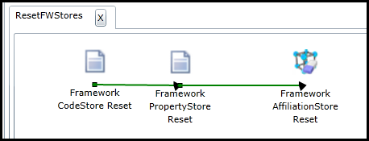
NexxusETL
Sandbox Refresh
The only job is ResetFWStores, this job is executed and used by the sandbox refresh process to reset all framework stores. This job should not be scheduled to run.

Slide 54
NexxusETL
MI_ONEAIM
This project is related to the OneAim solution to encompass and share Scientific Data (Publications, Clinical Trials, Congresses information …), as well as Business Intelligence information.

Slide 55
NexxusETL
MI_CEH_EXP
This is Customer Engagement Hub export project. The main job that should be scheduled is Main_MI_CEH_CEF-1_Scheduler_Exp.
The output is written to files, it then creates zip files for exported output files, bad and err files and then moves them to an Archive folder which is uploaded to the MoveIt location. The global variables that are used by this job are not listed in the existing MI11 DID but are defined in a separate DID that has mapping from MI to CEH (excel file ).

Slide 56
NexxusETL Loading faster with dedicated jobs

Slide 57
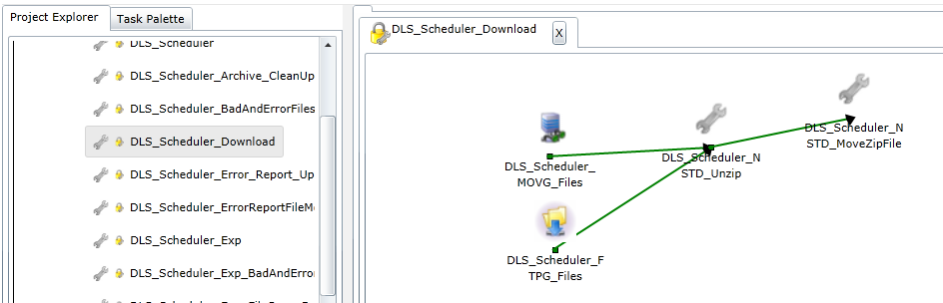
NexxusETL
Jobs exist in NexxusETL in order to make loading faster
For instance, if the field force of the Pharmaceutical Company has to be loaded, it is possible to use:
DLS_Scheduler_download: to take the files on the MoveIt or FTP server

Slide 58
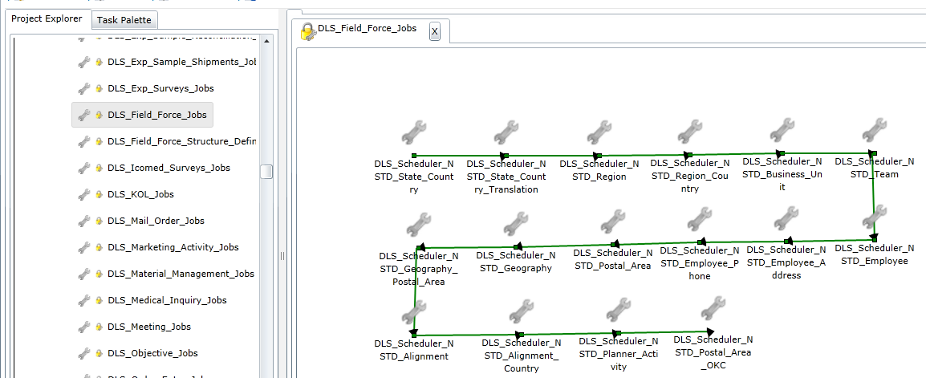
NexxusETL
Then,
DLS_Field_Force_Jobs: to load the interfaces linked to the field force of the Pharmaceutical Company
A valid .zip archive for the DLS_Field_Force_Jobs must contains only idl files

Slide 59
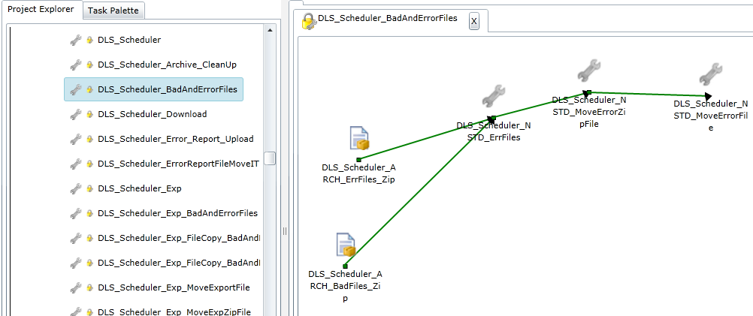
NexxusETL
Then,
DLS_Scheduler_BadAndErrorFiles: to zip the errors files and upload them on the MoveIt/FTP server

Slide 60
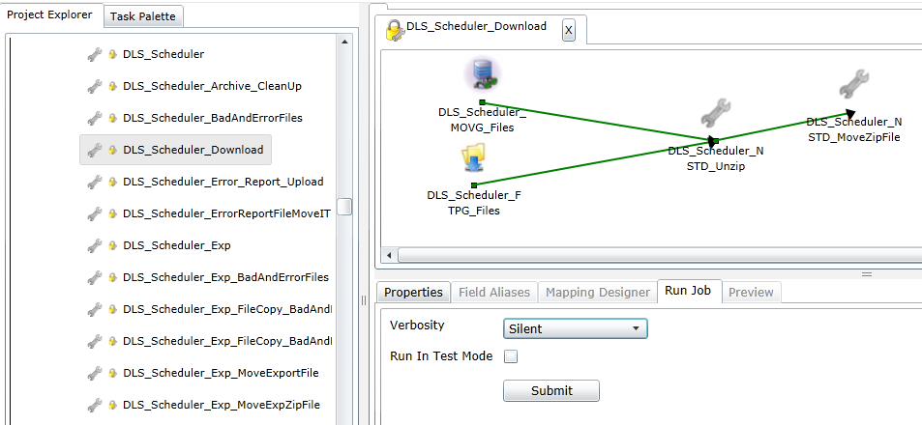
NexxusETL
To force the execution of a job:
1. Double click on its name in the Project Explorer
2. Select an item in the Designer section
3. Select the verbosity
4. Submit
2
1
3
4

Slide 61
NexxusETL
It is also possible to force a job execution through Force Administrator:

Slide 62
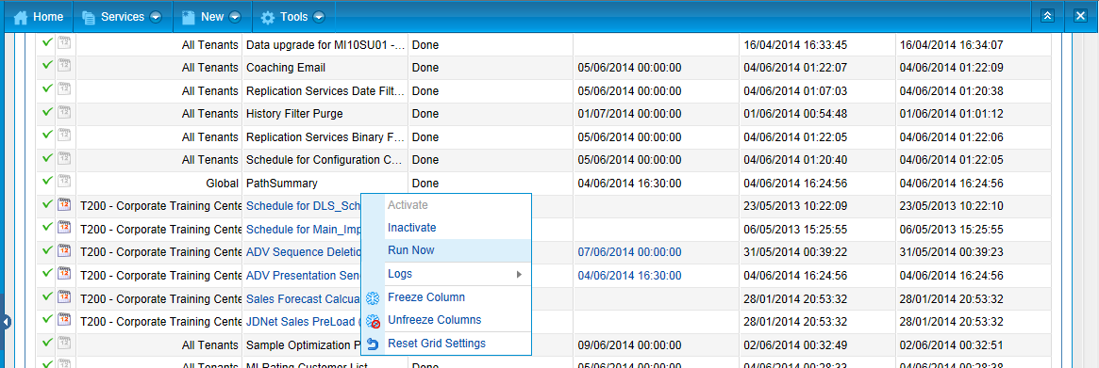
NexxusETL
Open the Scheduler and run the DLS job of your Tenant
Note that scheduled jobs can be inactivated directly from the Scheduler

Slide 63
NexxusETL
Loading one single file

Slide 64
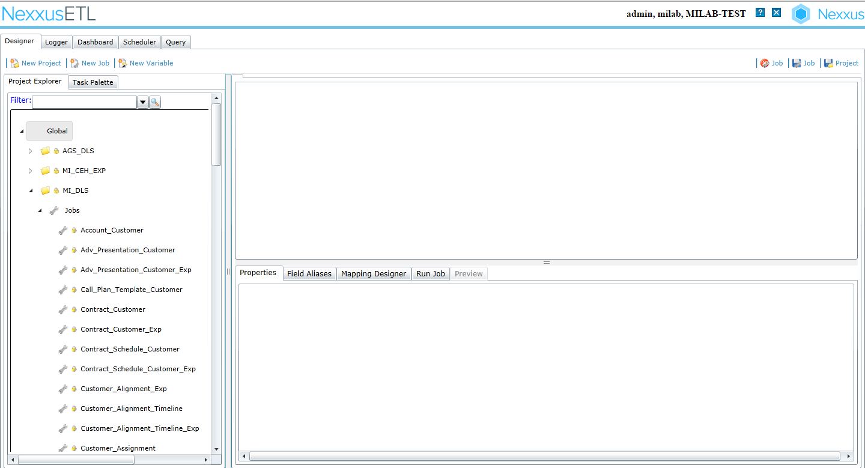
NexxusETL
Open the jobs in the ‘Project Explorer’

Slide 65
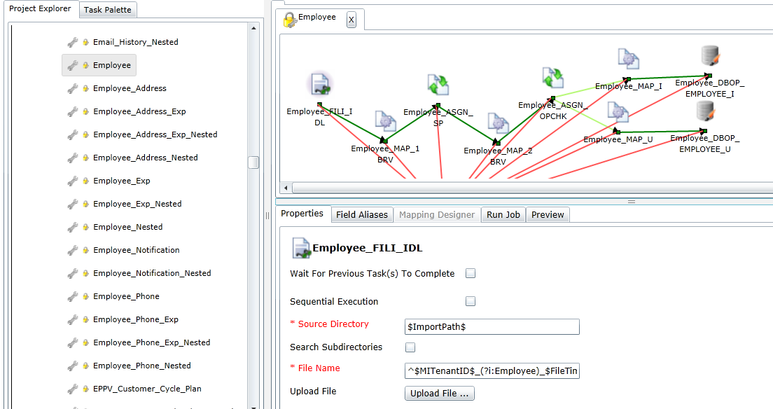
NexxusETL
Select the interface you want to load and upload the file
1
2
3

Slide 66
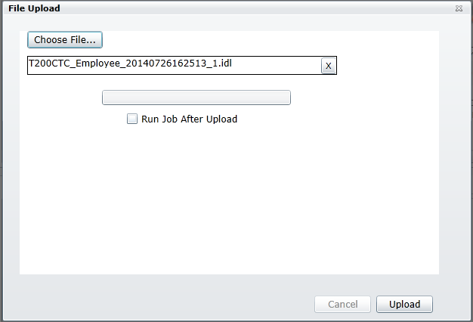
NexxusETL
Select the file from the local machine then click on “Upload”

Slide 67
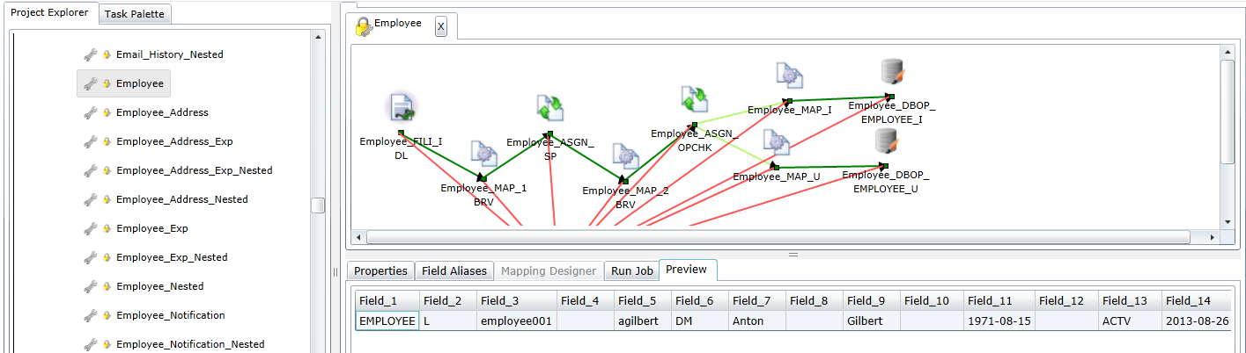
NexxusETL
It is possible to preview the data loading file

Slide 68

NexxusETL
Run the job

Slide 69

NexxusETL
To follow up the jobs activity: Go to “Logger” tab then “Progress”
REDUNDANT = Job was submitted at minimum a second time and therefore will not be executed.
DISPATCHED = Service Main thread has dispatched pending job to worker thread.
PROCESSING = Job is being processed.
PENDING = Job is waiting for processing.
DONE = Job was processed.
ABORTED = All phases of the job were aborted. This occurs for fatal errors like lost database connection.

Slide 70

NexxusETL
Errors can also be checked from the sub tab “Messages”
The Log Process Run Id is the unique identifier of each run.
Select the verbosity to be displayed by choosing one or more of the Log Types from the drop down list
Errors logs can be Exported to Excel file as a .csv or excel.xml file
Click in any column header to Sort display.

Slide 71



NexxusETL
On the server, two kind of files are generated:
.err files that gives the reason of the rejection
.bad files which contains the lines rejected
Notes:
Be careful, using this method to load data does not allow you to receive the errors logs in the MoveIt Account.
********************************************************************************************
Some sql queries that can be helpful :
See what job from which tenant is in the pipeline:
----------------------------------------------------------
select TENANT.TENANT_ID, TENANT.EXTERNAL_ID_1, TENANT.TENANT_NAME, DLT_JOB.JOB_NAME, a.STATUS, a.RUN_DATE as SCHEDULE_TIME,
case when a.STATUS = 'PROC' then a.START_TIME end as START_TIME,
case when a.STATUS = 'PROC' then systimestamp-a.START_TIME end as RUNTIME
from DLT_JOB_RUN a
inner join DLT_JOB on a.DLT_JOB_ID = DLT_JOB.DLT_JOB_ID
inner join TENANT on a.TENANT_ID = TENANT.TENANT_ID
where a.STATUS in ('SUBM','PEND','PROC','DISP')
order by a.DLT_JOB_RUN_ID desc
see from the current processing job what task where already done, (same information as the one in the dashboard…)
----------------------------------------------------------------------------------------------------------------------------------------------
select * from dlt_job_runstat where dlt_job_run_id in (select dlt_job_run_id from dlt_job_run where status = 'PROC') order by start_time desc

Slide 72

NexxusETL
The Dashboard tab brings an overall view of the results of the data loading
Selected job
Result of selected job

Slide 73
NexxusETL
A icon will be displayed if job ran with Rows Failed count > 0

Slide 74


NexxusETL
Monitoring User have a restricted NexxusETL access.
Only the Logger and Dashboard tabs are available for monitoring users
It will allow monitoring jobs in the tenant the user is associated with and the Global tenant 0, but they will not have the ability to modify, create or Submit jobs.

Slide 75


Data loading
Not only it is possible to load data inside Nexxus MI Database but also to extract data from MI Database through DLS_Scheduler_Exp
Extracted data will be deposited in MoveIt
Notes:
DLS_Scheduler_Exp, first step is to move the data from primary staging table to a secondary staging table.
Then the individual interface jobs, like Team_Exp, select from the secondary staging table and generate an output file.

Slide 76

Data loading
Extracted data will be stored in several tables then exported by NexxusETL
In the DLT_EXPORT_DATA table, The EXP_STATUS field makes incremental exports possible.
Standard export is not active for loaded data.
For example, a Team loaded via NexxusETL will not be extracted using standard export job.
But if this team is modified through the frontend, then the changes will be extracted on the next standard export.
Notes:
DLS_Scheduler_Exp, first step is to move the data from primary staging table to a secondary staging table.
Then the individual interface jobs, like Team_Exp, select from the secondary staging table and generate an output file.

Slide 77
NexxusETL
& Onekey data loading

Slide 78
Why F-I Format?
The change from OneKey Connect F-12 format was necessary because of the following reason
Profit from Technology change
In MI we will discontinue the usage of Xtelligent and replace it with NexxusETL.
The data load with NexxusETL is much faster than with Xtelligent
Opportunity to clean up
As a new interface for NexxusETL was needed, we took the opportunity to enrich the Data integration in MI and leverage from all available OneKey data.
Ease and speed up the implementation process
Key Goal of the project is to make the integration of OneKey into MI much faster and easier.

Slide 79
What are the advantages?
Key advantages of F-I & F-II Format:
Easy to integrate into MI
No confusions with various User Types in your project.
Improved logging and monitoring
In F-I & F-II format the logging and monitoring capabilities of the OneKey Interface has been improved.
Technical enhancements in terms of stability, performance and reliability
By using NexxusETL for the data integration we profit from all the advantages that NexxusETL. The previous table-space issues related to the OneKey loading should no longer be an issue when the system settings are in line with AE recommendation.
Simplicity in terms of connector setup
For multi country / multi tenant project, only one connector is needed (and not one per each Tenant)

Slide 80
What has changed?
Key differences of F-I / F-II compared to previous OneKey format :
New code Handling
Unified codes across Tenants and Systems
Simplified User Type Handling
No more separate User Type per country, because of OneKey integration
Notes:
The OneKey file format has been normalized to be closer from the MI format.

Slide 81
What has changed?
Key differences between F-I and F-II
F-II is available since MI9
Upgrade from F-I to F-II is not mandatory.
F-II is an evolution of F-I which brings:
Digital profile
Compliance file
Additional information in specialty files
Notes:
Compliance file link :
RESOURCE CENTER > Products & Solutions > Product Documents > Mobile Intelligence Suite
http://crm.cegedim-portal.com/resource/Product/FuncDocs/Mobile%20Intelligence%20Suite/DID_MI10_OneKey_-_F-II_Format.xls

Slide 82

What has changed?
Nexxus MI Europe
SP
UK
FR
User Type
Regions
OneKey Connector
Since OneKey F-I format, one User Type per OneKey Country is no longer automatically generated for a Tenant. The default User Type (here Nexxus MI Europe) – or a child User Type – is used for each country of the Client.
Client/OneKey codes are now filtered through the Region (a “UK” Rep will recover the customers with UK codes).
It is therefore mandatory to declare a Region on the Employee Profile.
Notes:
Compliance file link :
RESOURCE CENTER > Products & Solutions > Product Documents > Mobile Intelligence Suite
http://crm.cegedim-portal.com/resource/Product/FuncDocs/Mobile%20Intelligence%20Suite/DID_MI10_OneKey_-_F-II_Format.xls

Slide 83
What has changed?
Key differences between F-I & FII compared to previous OneKey Format.
Enhanced Performances
In the F-I or F-II format, geography data is provided by OneKey in a separate file named “Geography”.
Mapping between OneKey Brick type (UG1,UG2,UG3,UG4) and MI geography type (GEO1,GEO2,GEO3) is maintained by OneKey for each country and OneKey provides the MI geography code in the Geography file.
Flexible Customer Type Handling
Enables nearly all OneKey fields to be used for customer type mapping
Improved Loading process
Thanks to NexxusETL and the changed loading process, integration of Data is much faster and efficient

Slide 84
Performance Indicator
One of the main improvements is the data loading speed. On average the OneKey extraction has improved by over 300% and the MI dataload by more than 350%
Here are some example figures for one country:
In this scenario you could extract the data and reload MI in one day!
290.258 | Workplace
516.893 | Individual
180.282 | Address
936.945 | Affiliation
 | 914.265 | HardAffiliation incl. Self-Affiliation
 |  | 291.970 |  | Self-Affiliations (MI technical link)
 |  | 622.295 |  | Activities (OneKey Activities + HIE)
 | 22.680 | SoftwAffiliation (Relations)
OKC extraction |  |  | MI loading*
F-12 | F-I | in % | F-12 | F-I | in %
12:14 | 3:09 | 388% | 38:42 | 9:02 | 428%

Slide 85

DID-MI11_Changes Excel file
The best way to track changes per version is to use the DID-MI11_Changes document.
Notes:
RESOURCE CENTER > Products & Solutions > Product Documents > Mobile Intelligence Suite
http://crm.cegedim-portal.com/resource/Product/FuncDocs/Mobile%20Intelligence%20Suite/DID-MI11_Changes.xls

Slide 86

NexxusETL - ONEKEY
Data files in F-I and F-II should be loaded only with NexxusETL

Slide 87
NexxusETL - ONEKEY
It is possible to migrate F-12 format OneKey data to all more recent formats following the process described in the following document:
TCG-OKCode_Migration_Process_F-12_To_FI_Or_FII_Or_CEF-1_MI11
A Technical User Guide about OneKey Data load can be found here
Some additional documentation about F-1 format is available on Resource Center:
OneKey MI F-I General Presentation (A general Presentation about the Project)
OneKey F-I File Relation (Short overview over the new Interface with short description to each file
Notes:
RESOURCE CENTER > Products & Solutions > Product Documents > Mobile Intelligence Suite
Onekey Data Migration process :
http://crm.cegedim-portal.com/resource/Product/FuncDocs/Mobile%20Intelligence%20Suite/TCG-OKCode_Migration_Process_F-12_To_FI_Or_FII_Or_CEF-1_MI11.pdf
Technical User Guide about OneKey Data load
http://crm.cegedim-portal.com/resource/Product/FuncDocs/Mobile%20Intelligence%20Suite/TCG-OneKeyViaNexxusETL_MI11.pdf
Onekey MI F-1 General Presentation and OneKey F-1 File relation
http://crm.cegedim-portal.com/resource/Product/MI/Technical%20Documents/Forms/AllItems.aspx?RootFolder=/resource/Product/MI/Technical%20Documents/Mobile%20Intelligence%20Suite%206/HotFixReleases/HF-MI6-03/OneKey%20MI%20Interface&FolderC

Slide 88


NexxusETL - ONEKEY
In addition to NexxusETL settings in Force Administrator we saw previously, Some other settings are necessary to make OneKey data loading possible
Since F-I Format, it is possible to share a connector between all Tenants of an environment. As a consequence, the structure of OneKey path folders is shared in MoveIt as well.
With F-I / F-II or CEF-1 OneKey formats, if a connector is shared by several tenants of an environment, there is an additional folder in the connector directory.
This folder is named according to the Tenant Code

Slide 89

NexxusETL - ONEKEY
This is how OneKey data loading should be configured from Force Administrator:
1- Enabling OneKey
2- F- I and F-II and CEF-1 are the only possible formats
Set the Onekey Webservice Information at the tenant level

Slide 90

NexxusETL - ONEKEY
“Onekey Webservice Information” section: fields description:

Slide 91


NexxusETL - ONEKEY
This is how OneKey data loading should be configured from Force Administrator:
1- Click on Add New Country, choose one among the list
2- Click More Entries
3- If needed, more countries can be selected the same.
Notes:
If needed, several countries can be created. Proceed one country after another.

Slide 92


NexxusETL - ONEKEY
This is how OneKey data loading should be configured from Force Administrator:
select a Language and a
Language code, then save.
Region section fields are automatically filled
Notes:
If needed, several countries can be created. Proceed one country after another.

Slide 93
OneKey settings in NexxusETL

Slide 94

NexxusETL - ONEKEY
From the Project Explorer : Open and expand the
Appropriate OneKey project under the Global
Tenant then expand the Jobs list
Locate job Main_Imp_MI6_OKC_F-I or Main_Imp_OKC_F-II or Main_Imp_OKC_CEF-1 (depending on the format)
Right click on it, then select “Schedule Job”

Slide 95

NexxusETL - ONEKEY
Here, the job is
scheduled every day
Additional time to start the
job. Here the job can only
start between 00:00 and 00:05
‘Silent’ is the default setting for Verbosity
Beginning of the job
process
Select database to receive
all the error logs

Slide 96

NexxusETL - ONEKEY
No change to task flow or global variables should be done here!

Slide 97

NexxusETL - ONEKEY
To force the OneKey data loading in NexxusETL once (without scheduling), run Main_Imp_MI6_OKC_F-I or Main_Imp_OKC_F-II or Main_Imp_OKC_CEF-1 job
As usual, it is possible to check job status
through Logger and results via Dashboard tabs

Slide 98

NexxusETL - ONEKEY
It is also possible to force OneKey data loading through Force Administrator
Right click on the proper Onekey job then select « Run now »

Slide 99

NexxusETL - ONEKEY
The first column will display a for Active events (Activated in FA)
or if the event has been Inactivated in FA or NexxusETL.
The parameters specified on the NexxusETL Schedule Parameters tab are the same as the Force Administrator.

Slide 100


NexxusETL - ONEKEY
The Delete option will Inactivate a scheduled job without deleting the scheduler parameters

Slide 101


NexxusETL - ONEKEY
An Inactive job will be displayed with
Sign into Force Administrator to re-activate the job with the previous parameters
Services > Scheduler right click on job – select Activate

Slide 102

NexxusETL - ONEKEY
NexxusETL jobs are entered into an execution queue in the order in which they were submitted, indicated by the Job Run Id number.
From the Dashboard tab the user can change the job priority for Pending status jobs only.
Priorities can be re-assigned by tenant administrators and the Super User.
Right click on the job, then Click on Change Priority, the cursor turns to the hand icon
Drag and drop at new location in the list to increase or decrease the priority of the Pending job

Slide 103

NexxusETL - ONEKEY
Confirmation that the priority has changed is the cursor changing back to the arrow and the job in the new location

Slide 104

NexxusETL - ONEKEY

Slide 105

NexxusETL - ONEKEY
Server directory structure for a NexxusETL OneKey project

Slide 106

NexxusETL - ONEKEY
Information regarding data loading setting in Force Administrator are available through the tenant table

Slide 107

NexxusETL - ONEKEY
Global variables are in DLT_GLOBAL_VARIABLE table

Slide 108



NexxusETL - ONEKEY
Job status can be checked from DLT_JOB_RUN (name of the jobs are indexed within DLT_JOB thanks to the dlt_job_id field)

Slide 109
Change Requests Management

Slide 110



Change Requests Management

Slide 111

Change Requests Management
Main_Imp_MI6_OKC_F-I (or Main_Imp_OKC_F-II) role is to manage both OneKey data loading and OneKey data extraction (Change Request)

Slide 112


Change Requests Management
Generated Change Requests are deposited on the server then automatically uploaded on MoveIt.

Slide 113





Change Requests Management
Change Requests are then retrieved on the OneKey server and the validation status is updated by OneKey team
1- The user creates the Change Requests
in Nexxus MI : the database is enriched
2- NexxusETL extracts the Change Requests from Nexxus MI database and generates files archives on the Nexxus MI server thanks to “Main_Imp_MI6_OKC_F-I“ job or equivalent according to the format
3- the NexxusETL job zip the generated files and upload them on MoveIt
4- The archive is retrieved by OneKey Servers
MOVE IT
MI Environment
7- NexxusETL, via “Main_Imp_MI6_OKC_F-I“ updates Change Requests status in the database
6- The Change Requests files are sent back on MoveIt with an updated status and in a zip archive
8- The changes are eventually visible in Nexxus MI
5- The Change Requests are handled by OneKey Team

Slide 114
Change Requests Management
If two Initial OneKey files are successfully loaded in an environment and some customers are invalided between the first and the second OneKey Init files, the incremental OneKey File including these status changes must be loaded before the second Onekey Init file.
If this is not done, some invalid customers profiles will remain in Nexxus MI and be displayed with a wrong ‘Valid’ status !

Slide 115
Change Requests Management
Two OneKey initial files should never been loaded consecutively without incremental file in between. The risk is to keep invalid customers in the database
1/ M.I LAB just signed a contract with IMSHealth: A new environment is delivered and the client asks for a OneKey init file to start administration tasks.
2/ Main_Imp_MI6_OKC_F-I job is not scheduled yet in NexxusETL.
3/ The client works on administration but, in the meantime, some customers are invalidated in OneKey.
4/ The client finished and asks for a new OneKey Init, thinking Incremental files would be too heavy to be loaded.
5/ As a result, invalidated customers are not updated by the second OneKey Init (invalid customers are not distributed) : They will stay in the MI Database and will be shown with a ‘Valid’ status.
6/ The problem will be the same for affiliations (when an affiliation between a medical professional and a workplace is not valid anymore).

Slide 116
DOCUMENT UPDATES
Date (dd/mm/yyyy) | Version | Updates
10/08/2015 | 1.0 | First publication including enhancement and new features of version 11.
08/10/2015 | 2.0 | Minor graphic improvements and text corrections.
20/10/2015 | 3.0 | Former Slide 30 « The NexxusETL license must be created in the License Configuration tab of the tenant.” has been deleted (cf MIAP-43327)
04/11/2015 | 4.0 | Slide 26 : Fixing visual artifact + correcting slide 19
11/01/2015 | 5.0 | Minor graphic improvements and text corrections OneKey connect part has been removed
13/04/2016 | 6.0 | Various graphics changes

